Slide 1
DSO 560 NLP Google Play Store Apps Reviews Analysis
Feiran Zhang, Ge Zeng, Ranyue Yang, Xinyue Yu, Xiaoying Zou

Slide 2
Contents
Overview
Business Problem
Dataset Review
Preprocessing
Classification Modeling
Deep Learning Models
Feature Importance
Problematic Reviews
Topic Modeling
Business Insights from Topic Modeling
Future Improvement

Slide 3
Overview
1
Business Problem - Dataset Review - Preprocessing

Slide 4
Overview – Business Problem
How to classify a review as good/poor only based on the text?
Which features matter?
1
Classification
Modeling
Why do users give good/poor reviews?
How can the Apps improve?
2
Topic
Modeling

Slide 5
Overview – Roadmap
Identify Important Features
in Classification
Identify Important Topics
in Good/Poor Reviews
Explore and Clean Dataset
1
3
5
Problem 1
Problem 1
Problem 1
Problem 2
2
4
6
Build Classification Models
Build Topic Modeling
Future Improvements

Slide 6
Overview – Dataset Review
Dataset Introduction:
This dataset contains more than 50k reviews of Apps from Google Play Store which are categorized into Browsers, Video Players, File Managers, Mobile Payment, and Communication.
Important Features
Content: the reviews of the Apps.
Score: the corresponding rating of the review. (Values: 1 - 5, 1 is the lowest, 5 is the highest)
Category: Apps belonging to the categories. (Values: browsers, videoplayer, filemanager, payment, and communication)

Slide 7
Overview – Dataset Review
The distributions of categories are similar, hence we can analyze each category respectively;

Slide 8
Overview – Preprocessing
Original Dataset
(55744, 13)
Selected 3 important columns
Drop Duplicates & Drop NAN
(49589, 3)
Replace Emoji, URL, etc.
Use Textacy
Why do we keep
“n’t” words?
Lemmatization
Deal with “n’t” words before lemmatization - (49589, 4)
+ (‘content_lemma’)
Regex
(49589, 5)
+ (‘content_regex’)
The “n’t” words will change the sentiment of a review.
Stopword List
Remove “n’t” words
Append some punctuations
Prepared Dataset
(49589, 5)

Slide 9
Classification Modeling
2
Deep Learning Models – Feature Importance
– Problematic Reviews

Slide 10
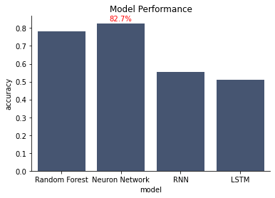
Classification Modeling – Deep Learning Models
Best Result:
A simpler deep learning architecture has the best performance with 82.7% accuracy, outperforming a brute random guess significantly by 32.7%.
Models Comparison:
Random Forest and Neural Network perform much better than deep learning architectures with more complexity, i.e. RNN and LSTM, which do not perform so well in our sentiment analysis of app reviews.
Precision-Recall Balance:
The confusion matrix returned by this model indicates a fairly good balance between precision (79%) and recall (78%).
Confusion Matrix | Predicted Positives | Predicted Negatives
Actual Positives | 1,381 | 351
Actual Negatives | 273 | 1,598

Slide 11
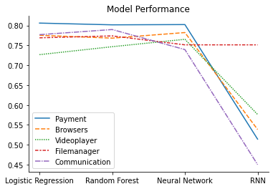
Classification Modeling – Neural Network
Model Architecture of Neural Network
This model was established using our own trained TF-IDF vectorization embedding with N-gram = (1,3).
The model uses a sigmoid function to output the probability of a positive/negative review (score of 5 being positive and score of 1 being negative).
Model Hyperparameters:
Vocab Size = 5,000, Max Length = 493, Embedding Size=50
Layers: Embedding (Our Own Trained TF-IDF Vectorization), Flatten(), Dense (1 Unit Sigmoid)

Slide 12
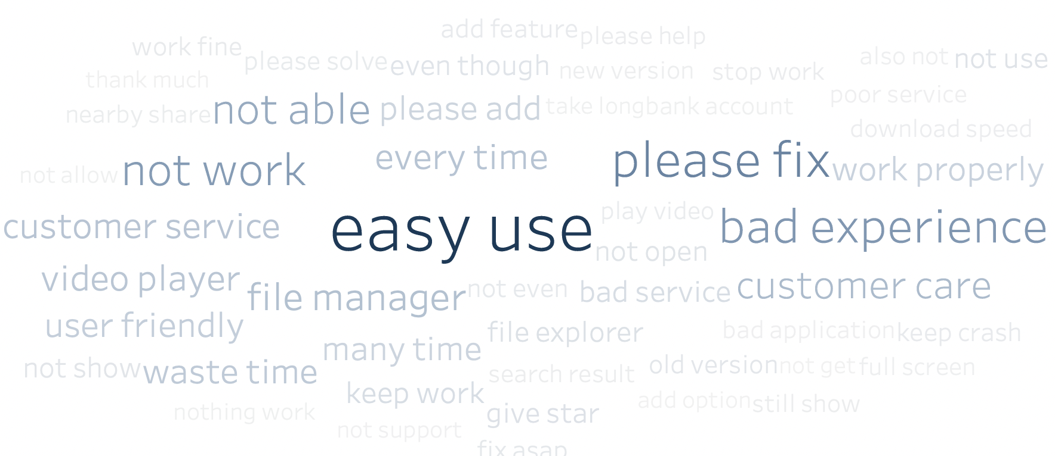
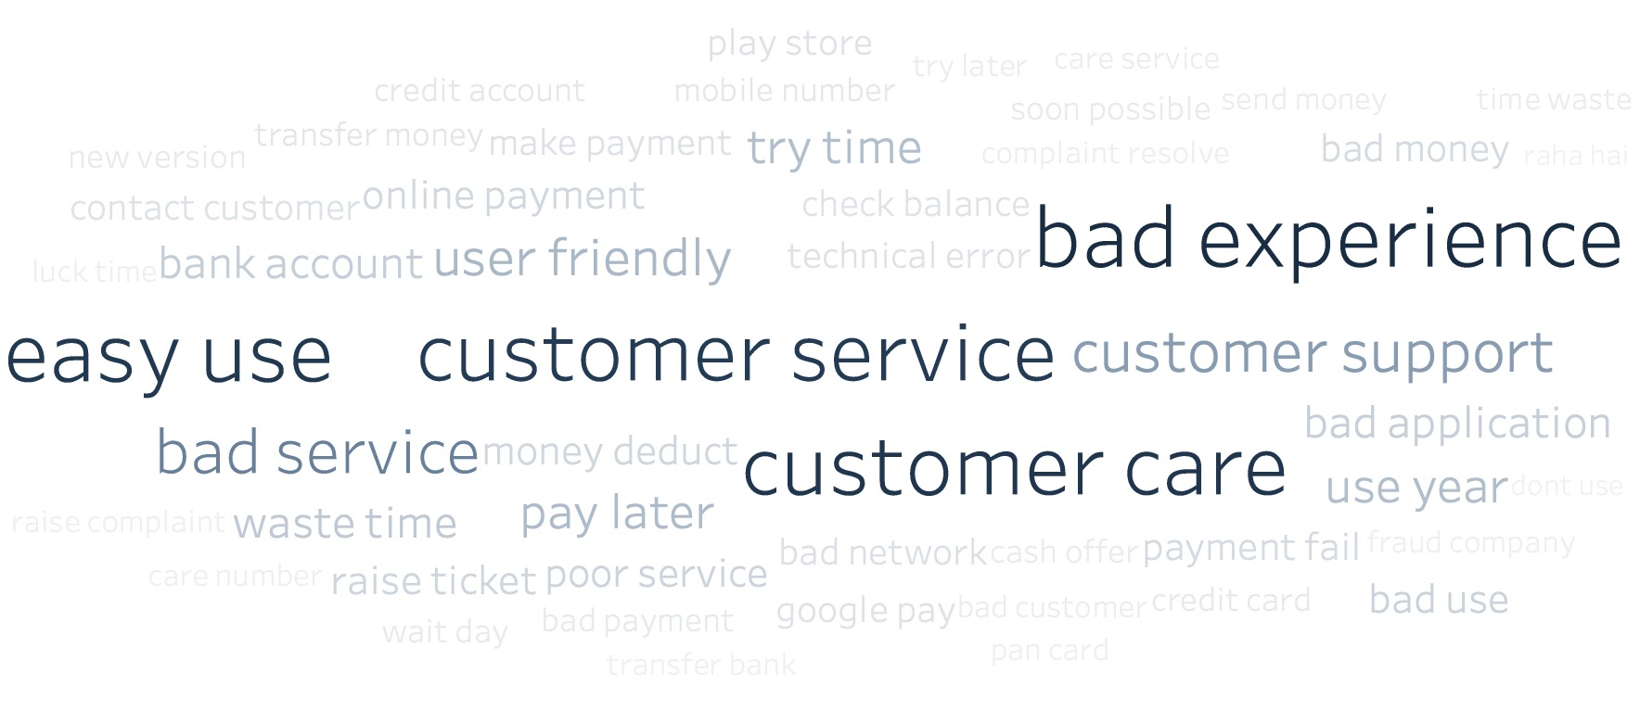
Classification Modeling - Feature Importance
Overall
Payment
Using the whole dataset, the most important features are "easy use", "please fix", "bad experience", "not work" and so on.
In general, the success of an App is highly related to whether it is easy to use and whether there are some bugs in it.
Using the data of payment Apps, the most important features are "customer service", "easy use" and so on.
For payment Apps, the company should focus more on the customer service and easiness

Slide 13
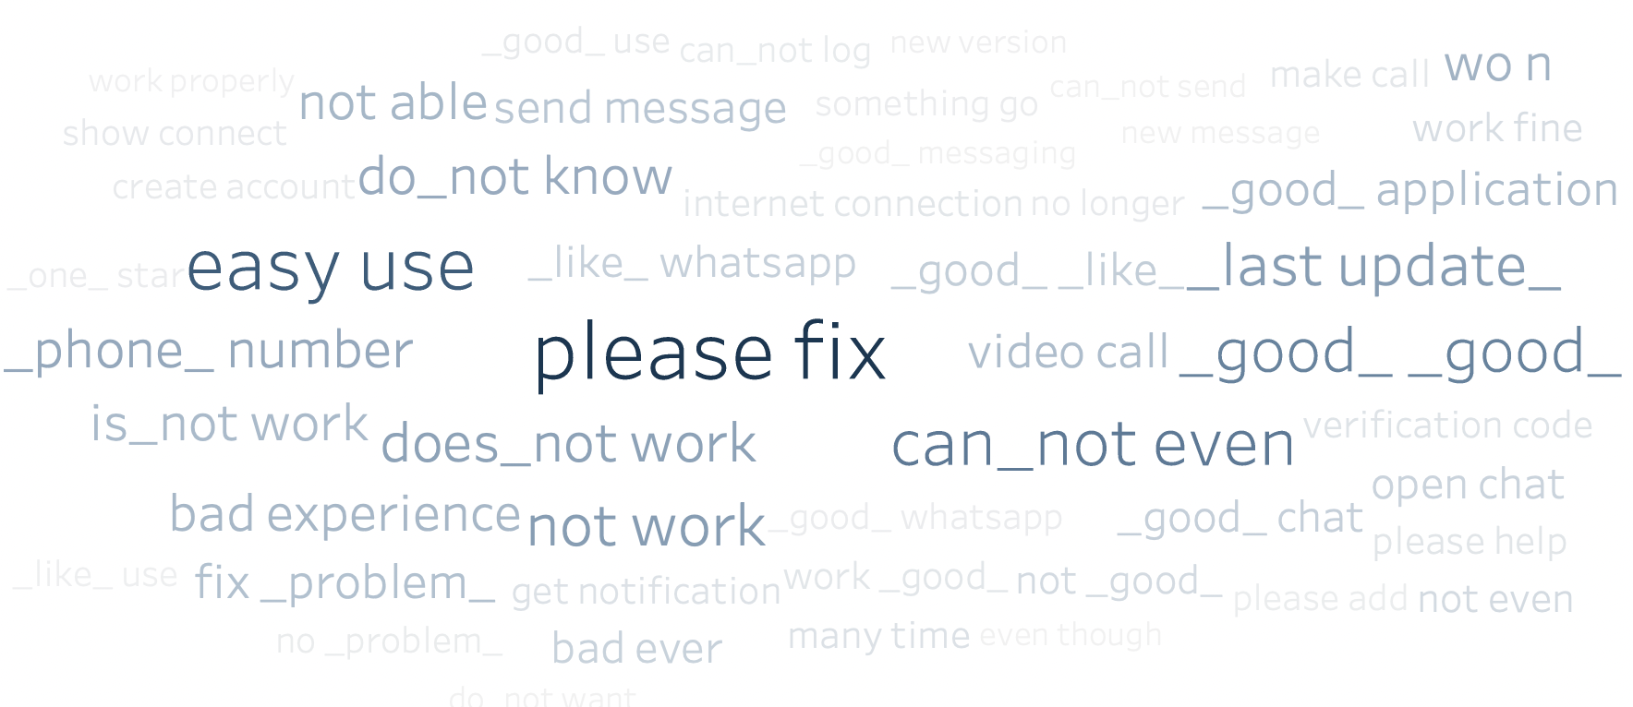
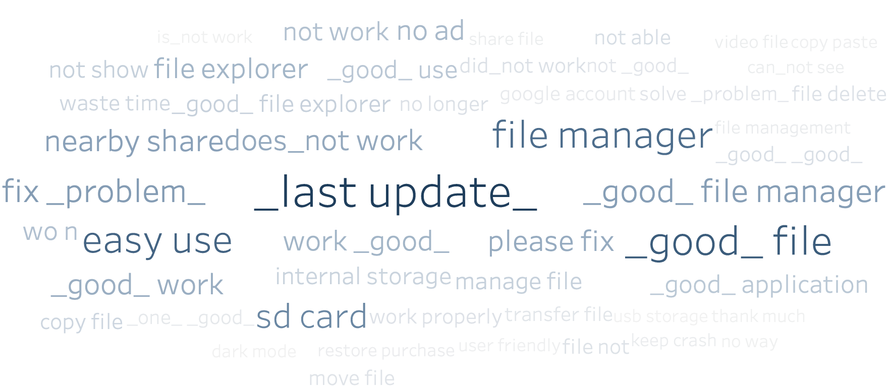
Classification Modeling - Feature Importance
Communication
File Manager
Using the data of communication Apps, the most important features are "please fix", "good", "easy use" and so on.
For communication Apps, the companies should focus more on fixing bugs and easiness of their Apps.
Using the data of file managers, the most important features are "last update", "good file manager", "nearby share" and so on.
For file manager Apps, the company should focus more on the update of their Apps and the function of nearby sharing.

Slide 14
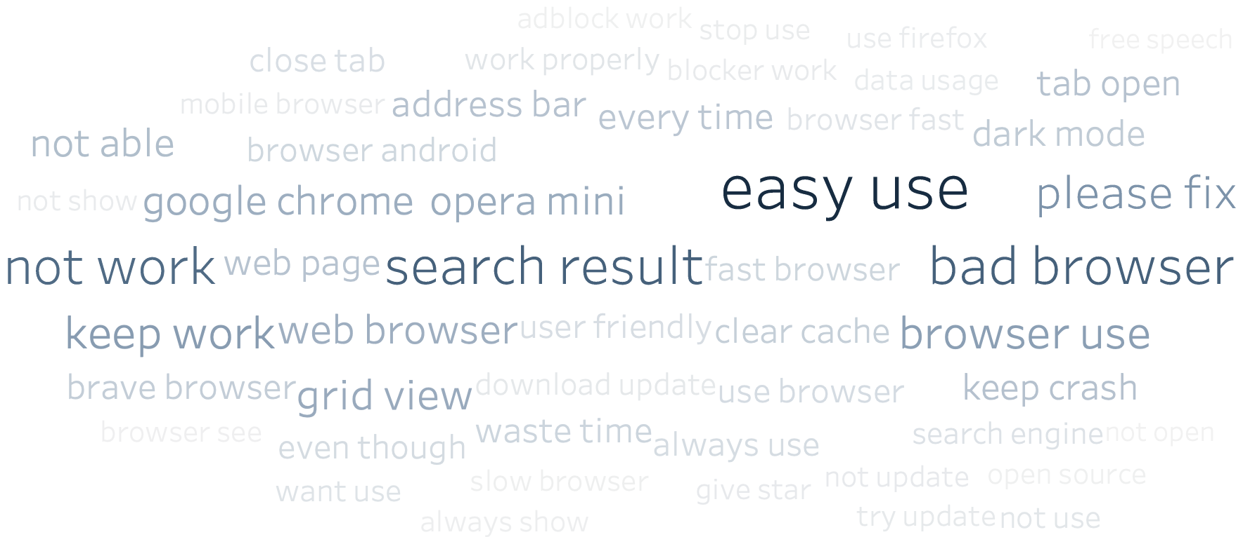
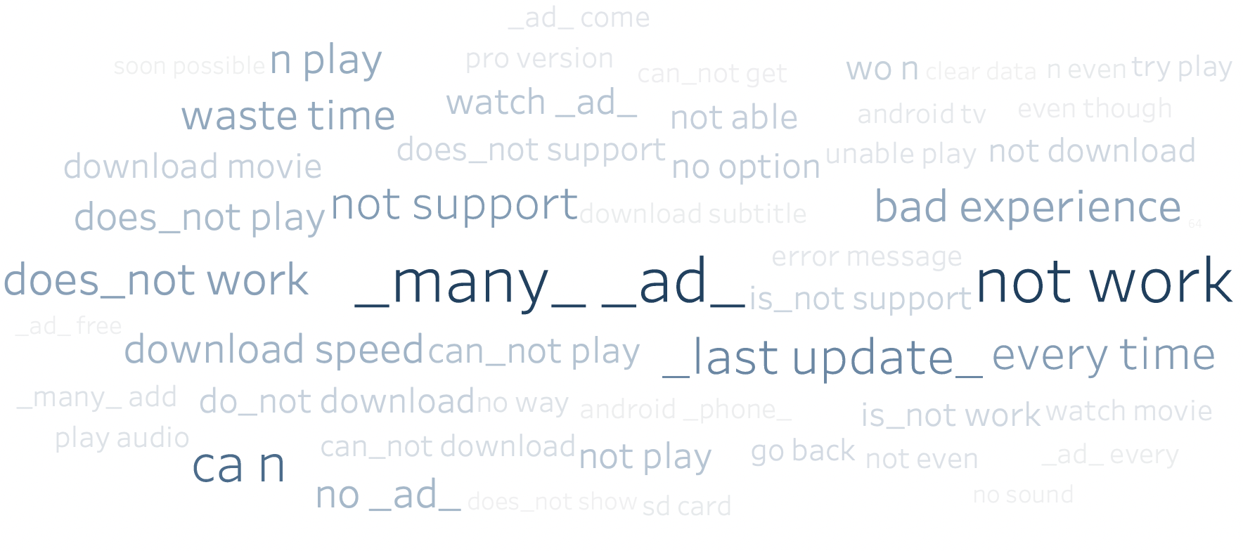
Classification Modeling - Feature Importance
Browsers
Video Player
Using the data of browsers, the most important features are "easy use", "search result", "bad browser", "grid view" and so on.
For browser Apps, the company should focus more on easiness and improving search result of their Apps.
Using the data of video players, the most important features are "many ad", "not work", "not support" and so on.
For video player Apps, the company should focus more on the support for varies format of videos and find the balance between user experience and the number of ads.

Slide 15
Classification Modeling - Problematic Reviews
Spurious Negative Prediction
Spurious Positive Prediction
"Generaly speaking, Whatsapp is very helpful and user friendly... But there is a major drawback of Whatsapp..... There is no "Edit " option... So once you post your message in Whatsapp, the content of the message becomes permanent... Even if there is some spelling mistakes, you cannot correct it anymore .... But Telegram has edit option. So Telegram has an edge over Whatsapp... So if Whatsapp wants to retain its users, Edit option should be there in future upgrade of Whatsapp."
"Why the search page isn't opening in the first go after the last update? User have to search the same thing twice unnecessarily."
Score: 5.0 (Positive) Prediction: Negative
Score: 1.0 (Negative) Prediction: Positive
Analysis - Wrong Given Score
Our model successful captures the negative sentiment of this review which has a spurious 5.0 score. The true sentiment is inconsistent with the actual score given. Thus, our model can be applied as a complementary testing tool to the existing rating system.
Analysis - Wrong Prediction
There are important tokens such as 'helpful' and 'user friendly' in the review, which show frequently in our good reviews and make our model predict it as positive. But the overall signal of the review is negative since the user is much more concerned about the drawbacks of Whatsapp.

Slide 16
Topic Modeling
3
Business Insights from Topic Modeling

Slide 17

What is the Business Insights?

Slide 18
Topic Modeling – Payment (Positive Reviews)
Bank Money Transfer
Easy Features & User Friendly Interface
Improve automatic money transfer features and remind customers to set up regular frequent transactions
Cooperate with more banks for wider coverage of the banking system
Decrease money processing time by enhancing telecommunications with banks
Stick to intuitive and simple design styles and user-friendly interfaces
Positive
Aspects
&
Reasons
Sending Money
Use fraud analytics algorithms to detect transaction anomaly and ensure transaction safety
Expand identity verification methods including username, phone numbers, email, etc.

Slide 19
Topic Modeling – Payment (Negative Reviews)
Customer Service
Bank Account Update
Ensure the accessibility of customer service by increasing customer hotlines and online receptionists
Establish a formal procedures to handle customer complains and process refund requests within
a specific timeframes (such as in 3 days)
Adjust transaction fee according to the estimated time between payment applications and bank accounts
Add email and text notification features to notify customers of the current stage of transactions
Negative Aspects
&
Solutions
Pay Later Feature Failure
Technical Problems
Conduct credit scoring for profile screening and use credit metrics as reference of transaction approvals
Increase the options of payment dates so customers can choose to repay on different dates
Monitor technical issues on a daily and weekly basis,
Analyze the cause of these issues through daily transaction data and customer complaints and debug

Slide 20
Topic Modeling – Browser (Positive Reviews)
Easy To Use Features
Dark Mode & Data Saving Mode
Streamline features that are less likely to be used and keep user interface neat and clear
Highlight no tracking and automatic deleting browsing history options to ensure users of data privacy and security
Design more dark mode options and improve dark mode layout for dark modes to increase visibility in different environments
Set up an automatic reminder feature for users to transfer to data saving modes when the battery is below a certain threshold
Positive Aspects
&
Reasons
Extension Support
Desktop Versions
Test the compatibility with different browser extensions on a regular basis
Improve the functionality of high-frequency browser extensions
Adjust browser features according to different platforms to customize different platforms
Improve the automatic syncing features of bookmarks and browsing histories

Slide 21
Topic Modeling – Browser (Negative Reviews)
Update Failure
AdBlock Failure
Remember user preference of automatic software update
Avoid automatic update when users reject the options
Report update failure cases, analyze the cause of failures and debug accordingly
Monitor and test the AdBlock features to check AdBlock performance on different websites
Customize AdBlock features according to different websites and dynamically adjust the features
Positive
Aspects
&
Solutions
Forced Grid View
Increase view options for users to choose between cascade view and grid view
Survey and research user experience preference before conducting software updates

Slide 22
Topic Modeling – Video Player (Positive Reviews)
No ad
Support Multiple Format
Provide video players without intrusive ads
Create a non-ad version for users to choose from
Support different formats of video such as MP4, MOV, FLV, AVI
Support Android TV and other smart TV
Many Feature
Positive Aspects
&
Reasons
Good for Movie Watching
Provide option to switch between languages for dual audio vids
Provide features similar to PC version to increase the loyalty of existing PC users
Add feature of pan zoom which users can freely zoom video
Customize number of seconds to skip
Customize audio
Ensure movie can load in quickly
Provide automatic recognition subtitles in different languages
Provide 4K version for video to improve the user experience in movie watching

Slide 23
Topic Modeling – Video Player (Negative Reviews)
Crashing in Latest update
Too many ad
Ensure new version work properly before launching new version
Fix issue like (1) when forward the video, audio doesn’t stop (2) screen turn off when video is playing (3) OTG connection problem
Reduce the length of ads or even provide a non-ad version to increase the user retention
Positive
Aspects
&
Solutions
Format Not Support
Support more video format such as MPEG4, HEV, OPUS, HEVC
Support 4K video which is an increasing need
Add more audio format like AAC, EAC3, AC3

Slide 24
Topic Modeling – Communication (Positive Reviews)
Video Call
Easy to Use
Support video calls in communication app, which is an increasing need
Support group video call for a larger number of users instead of only 4
Available across all platforms such as Android, IOS, windows, etc.
Ensure the video call is clear, smooth, and fast
Put common features in a prominent place
Provide user tutorials to new users
Keep consistence when updating to new version
Positive
Aspects
&
Reasons
Status Option
Provide status options for users to show their real-time status

Slide 25
Topic Modeling – Communication (Negative Reviews)
Phone Number
Video Call Problem
Improve security and privacy by owning users’ phone number
Allow users to sign up using email if the PC version does not require a phone number
Provide automatic identification of phone numbers to enable users copy & paste phone numbers easily
Provide an appropriate way to solve the “phone number already exists” problem
Provide minimize square frame for video while in chatting page
Fix video call auto rotate issue, provide manual rotate option
Ensure smooth switching to cellular data when WIFI is disconnected
Reduce battery consumption for video calls
Negative
Aspects
&
Solutions
Message Sending Issue
Provide option to send message to multiple users at one time
Improve message sending speed
Show specific reason for the issue when users couldn’t send the message successfully

Slide 26
Topic Modeling – File Managers (Positive Reviews)
Easy to use
No ad
Design a user-friendly and easy-to-use interface
Highlight the most important features for users' daily use
Improve constantly the user interface design
Ensure app service quality without intrusive ads
Find the balance between user experience and the number of ads to increase the profit
Positive
Aspects
&
Reasons
Free of Charge
Continue to provide free file manager service to users

Slide 27
Topic Modeling – File Manager (Negative Reviews)
Run Slowly
Update Problem
Ensure the file preprocessing performance after users use it for a long time
Fix the problem of crashing after long-time use
Optimize the Apps to enable user use less memory and run faster
Combine the adjustment in features in several updates to reduce the number of updates
Negative
Aspects
&
Solutions
SD Card Issue
Fix the problem of reading and writing the file from the SD card
Ensure that the apps can detect various types of SD cards

Slide 28
Future Improvement
4

Slide 29
Future Improvement
Data Cleaning
Clean reviews more thoroughly and reasonably to achieve higher accuracy
Modeling
Try more models such as transformer and BERT to seek better classification results
Do oversampling based on the ‘thumbupcount’ to consider the impact of thumb-ups in each review
Feature Engineering
Explore how to Choose a better topic size;
try to avoid the same words appearing in different topics
Topic Modelling

Slide 30
THANKS!
Any questions?
You can find us at
zoux@usc.edu

